Slide 1

MIRPUR UNIVERSITY OF SCIENCE AND TECHNOLOGY (MUST), MIRPUR DEPARMENT OF COMPUTER SCIENCE & INFORMATION TECHNOLOGY

Slide 2
Professional Practices Lecture [8] Software Engineering Ethics and Professional Conduct
Dr. Aum Tariq
(Lecturer)
Date: April 23, 2020

Slide 3

Today’s Agenda
Continue from previous lecture….
Software Engineering Ethics and Professional Conduct
SWENET OSE3 Module ..

Slide 4
Principle-4: Judgement
4.01. Moderate all technical judgments by the need to support and maintain human values.
4.02 Only endorse (support) documents either prepared under their supervision or within their areas of competence and with which they are in agreement.
4.03. Maintain professional objectivity with respect to any software or related documents they are asked to evaluate.

Slide 5
Principle-4: Judgement
4.04. Not engage in unreliable financial practices such as corruption, double billing, or other improper financial practices.
4.05. Disclose to all concerned parties those conflicts of interest that cannot reasonably be avoided or escaped.
4.06. Refuse to participate, as members or advisors, in a private, governmental or professional body concerned with software related issues, in which they, their employers or their clients have undisclosed potential conflicts of interest.

Slide 6
Principle-5: Management
5.06. Attract potential software engineers only by full and accurate description of the conditions of employment.
5.07. Offer fair and just remuneration.
5.08. Not unjustly prevent someone from taking a position for which that person is suitably qualified.
5.09. Ensure that there is a fair agreement concerning ownership of any software, processes, research, writing, or other intellectual property to which a software engineer has contributed.
5.10. Provide for due process in hearing charges of violation of an employer's policy or of this Code.
5.11. Not ask a software engineer to do anything inconsistent with this Code.
5.12. Not punish anyone for expressing ethical concerns about a project.

Slide 7
Principle-5: Management
5.01 Ensure good management for any project on which they work, including effective procedures for promotion of quality and reduction of risk.
5.02. Ensure that software engineers are informed of standards before being held to them.
5.03. Ensure that software engineers know the employer's policies and procedures for protecting passwords, files and information that is confidential to the employer or confidential to others.
5.04. Assign work only after taking into account appropriate contributions of education and experience tempered with a desire to further that education and experience.
5.05. Ensure realistic quantitative estimates of cost, scheduling, personnel, quality and outcomes on any project on which they work or propose to work, and provide an uncertainty assessment of these estimates.

Slide 8
Principle-6: Profession
6.01. Help develop an organizational environment favorable to acting ethically.
6.02. Promote public knowledge of software engineering.
6.03. Extend software engineering knowledge by appropriate participation in professional organizations, meetings and publications.
6.04. Support, as members of a profession, other software engineers striving to follow this Code.
6.05. Not promote their own interest at the expense of the profession, client or employer.

Slide 9
Principle-6: Profession
6.06. Obey all laws governing their work, unless, in exceptional circumstances, such compliance is inconsistent with the public interest.
6.07. Be accurate in stating the characteristics of software on which they work, avoiding not only false claims but also claims that might reasonably be supposed to be speculative, vacuous, deceptive, misleading, or doubtful.
6.08. Take responsibility for detecting, correcting, and reporting errors in software and associated documents on which they work.
6.09. Ensure that clients, employers, and supervisors know of the software engineer's commitment to this Code of ethics, and the subsequent ramifications of such commitment.

Slide 10
Principle-6: Profession
6.10. Avoid associations with businesses and organizations which are in conflict with this code.
6.11. Recognize that violations of this Code are inconsistent with being a professional software engineer.
6.12. Express concerns to the people involved when significant violations of this Code are detected unless this is impossible, counter-productive, or dangerous.
6.13. Report significant violations of this Code to appropriate authorities when it is clear that consultation with people involved in these significant violations is impossible, counter-productive or dangerous.

Slide 11
Principle-7: Colleagues
7.01. Encourage colleagues to adhere to this Code.
7.02. Assist colleagues in professional development.
7.03. Credit fully the work of others and refrain from taking undue credit.
7.04. Review the work of others in an objective, honest, and properly-documented way.
7.05. Give a fair hearing to the opinions, concerns, or complaints of a colleague.

Slide 12
Principle-7: Colleagues
7.06. Assist colleagues in being fully aware of current standard work practices including policies and procedures for protecting passwords, files and other confidential information, and security measures in general.
7.07. Not unfairly intervene in the career of any colleague; however, concern for the employer, the client or public interest may compel software engineers, in good faith, to question the competence of a colleague.
7.08. In situations outside of their own areas of competence, call upon the opinions of other professionals who have competence in that area.

Slide 13
Principle-8: Self
8.01. Further their knowledge of developments in the analysis, specification, design, development, maintenance and testing of software and related documents, together with the management of the development process.
8.02. Improve their ability to create safe, reliable, and useful quality software at reasonable cost and within a reasonable time.
8.03. Improve their ability to produce accurate, informative, and well-written documentation.
8.04. Improve their understanding of the software and related documents on which they work and of the environment in which they will be used.

Slide 14
Principle-8: Self
8.05. Improve their knowledge of relevant standards and the law governing the software and related documents on which they work.
8.06 Improve their knowledge of this Code, its interpretation, and its application to their work.
8.07 Not give unfair treatment to anyone because of any irrelevant prejudices.
8.08. Not influence others to undertake any action that involves a breach of this Code.
8.09. Recognize that personal violations of this Code are inconsistent with being a professional software engineer.

Slide 15
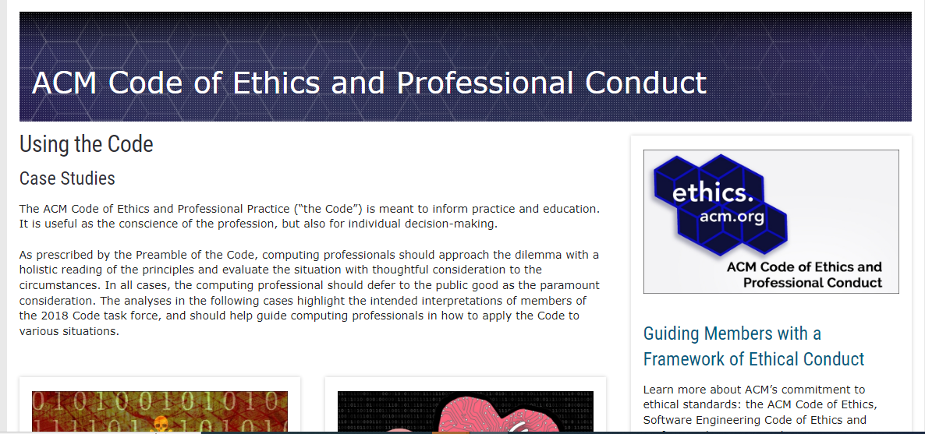
https://www.acm.org/code-of-ethics/case-studies

Slide 16
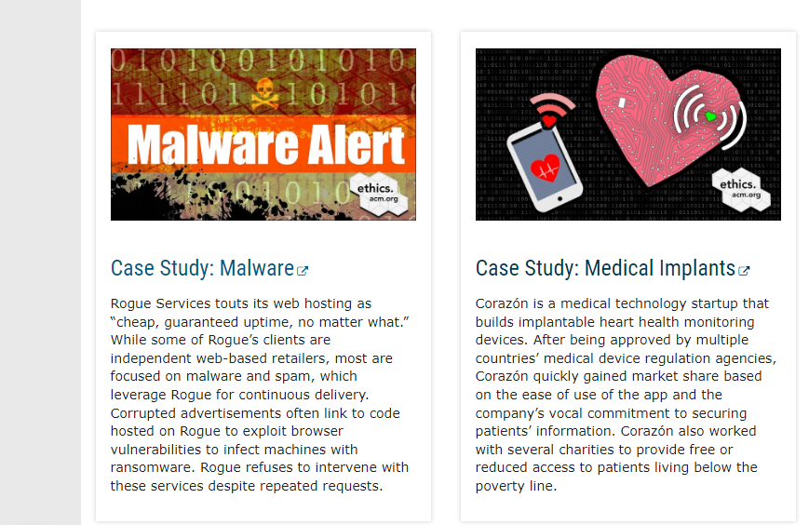

Slide 17
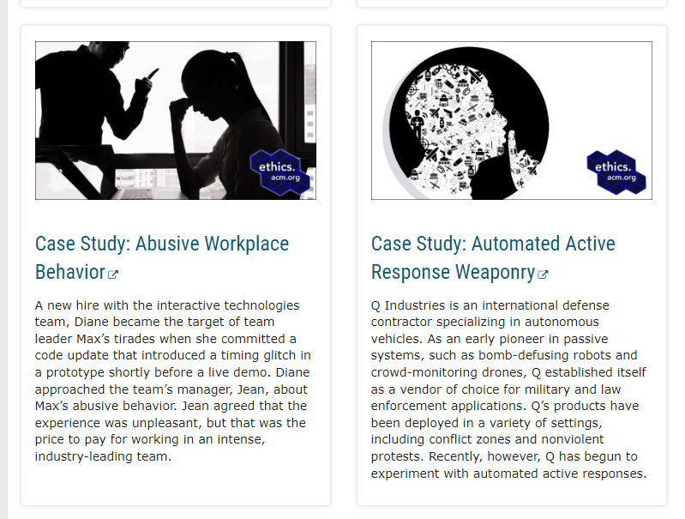

Slide 18
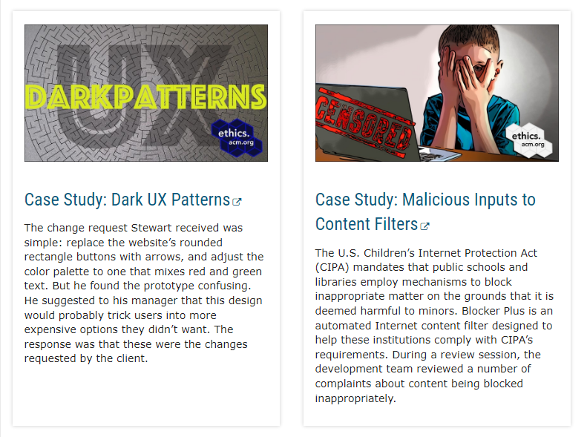

Slide 19
References
Accreditation Board for Engineering and Technology home page:
Abet.org. 2020. ABET | ABET Accreditation. [online] Available at: <https://www.abet.org/> [Accessed 3 May 2020].

Slide 20
THANKS

